Slide 1
left factoring and first & follow
By
Attia Agha

Slide 2
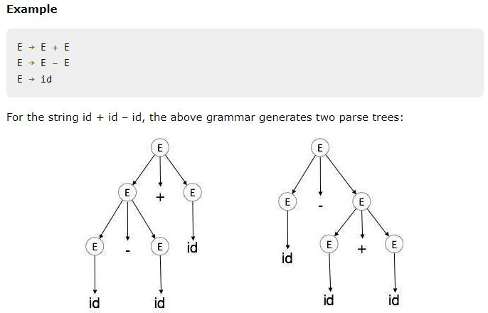
Ambiguity
A grammar G is said to be ambiguous if it has more than one parse tree (left or right derivation) for at least one string.
The language generated by an ambiguous grammar is said to be inherently ambiguous. Ambiguity in grammar is not good for a compiler construction. No method can detect and remove ambiguity automatically, but it can be removed by either re-writing the whole grammar without ambiguity.

Slide 3
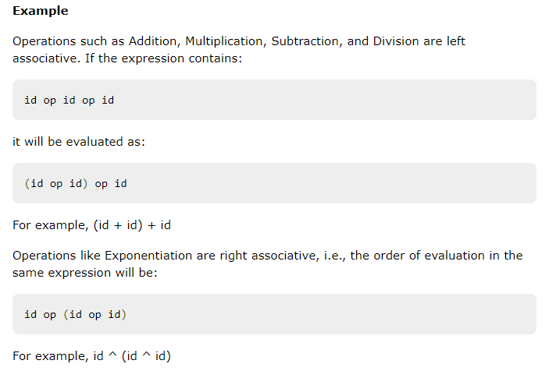
Associativity
If an operand has operators on both sides, the side on which the operator takes this operand is decided by the associativity of those operators. If the operation is left-associative, then the operand will be taken by the left operator or if the operation is right-associative, the right operator will take the operand.

Slide 4
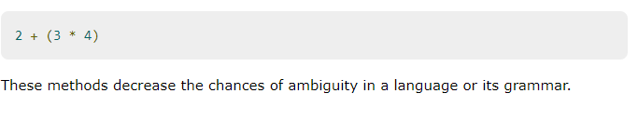
Precedence
If two different operators share a common operand, the precedence of operators decides which will take the operand. That is, 2+3*4 can have two different parse trees, one corresponding to (2+3)*4 and another corresponding to 2+(3*4). By setting precedence among operators, this problem can be easily removed. As in the previous example, mathematically * (multiplication) has precedence over + (addition), so the expression 2+3*4 will always be interpreted as:

Slide 5
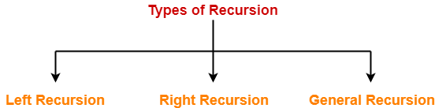
Left-Recursion
Left-Recursion S → Sa / ∈
Right-Recursion S → aS / ∈
General-Recursion S → aSb / ∈
A production of grammar is said to have left recursion if the leftmost variable of its RHS is same as variable of its LHS.
A grammar containing a production having left recursion is called as Left Recursive Grammar.

Slide 6
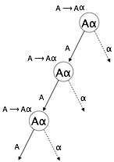
Left-Recursion
A → Aα / β
Left recursion is considered to be a problematic
situation for Top down parsers.
Therefore, left recursion has to be eliminated from
the grammar.
Left-Recursion Elimination
we can eliminate left recursion by replacing the pair
of productions with-
A → βA’
A’ → αA’ / ∈

Slide 7
Left-Factoring
Left factoring is a process by which the grammar with common prefixes is transformed to make it useful for Top down parsers.
Example
A → αβ1 / αβ2 / αβ3
This kind of grammar creates a problematic situation for Top down parsers.
Top down parsers can not decide which production must be chosen to parse the string in hand.
To remove this confusion, we use left factoring.

Slide 8
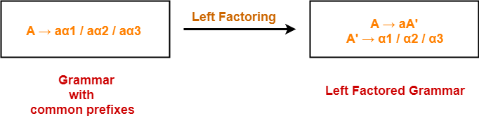
Left-Factoring

Slide 9
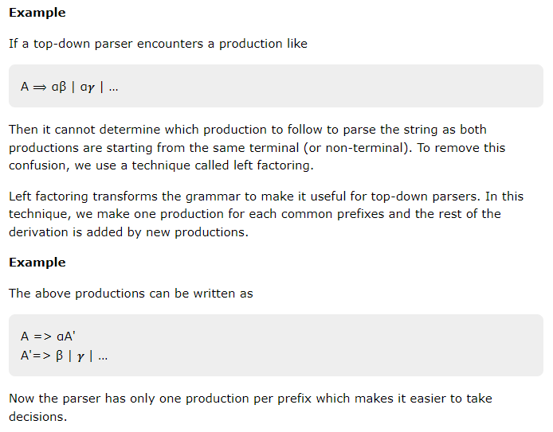
If more than one grammar production rules has a common prefix string, then the top-down parser cannot make a choice as to which of the production it should take to parse the string in hand.

Slide 10

Why first
We saw the need of backtrack in the previous lecture of on Introduction to Syntax Analysis, which is really a complex process to implement. There can be easier way to sort out this problem:
If the compiler would have come to know in advance, that what is the “first character of the string produced when a production rule is applied”, and comparing it to the current character or token in the input string it sees, it can wisely take decision on which production rule to apply.
Let’s take the same grammar from the previous

Slide 11
Example cont.
in the example above, if it knew that after reading character ‘c’ in the input string and applying S->cAd, next character in the input string is ‘a’, then it would have ignored the production rule A->bc (because ‘b’ is the first character of the string produced by this production rule, not ‘a’ ), and directly use the production rule A->a (because ‘a’ is the first character of the string produced by this production rule, and is same as the current character of the input string which is also ‘a’).
Hence it is validated that if the compiler/parser knows about first character of the string that can be obtained by applying a production rule, then it can wisely apply the correct production rule to get the correct syntax tree for the given input string.

Slide 12
FIRST Set in Syntax Analysis
FIRST(X) for a grammar symbol X is the set of terminals that begin the strings derivable from X.
FIRST set is a concept used in syntax analysis, specifically in the context of LL and LR parsing algorithms. It is a set of terminals that can appear immediately after a given non-terminal in a grammar.
The FIRST set of a non-terminal A is defined as the set of terminals that can appear as the first symbol in any string derived from A. If a non-terminal A can derive the empty string, then the empty string is also included in the FIRST set of A.
The FIRST set is used to determine which production rule should be used to expand a non-terminal in an LL or LR parser. For example, in an LL parser, if the next symbol in the input stream is in the FIRST set of a non-terminal, then that non-terminal can be safely expanded using the production rule that starts with that symbol.

Slide 13
Cont.
It is worth noting that FIRST set is also used in computing FOLLOW set, which is a set of terminals that can appear immediately after a non-terminal in a grammar. FOLLOW set is used in LR parsing, which requires more information than LL parsing.
To compute the FIRST set of a grammar, one can start with all terminals having the respective terminal in their FIRST set and continue the process by adding the first terminal of the right-hand side of the production to the set of the non-terminal in the left-hand side of the production. Repeat this process until no new element can be added to any set.

Slide 14
Cont.
FIRST set is a fundamental concept in syntax analysis, and it is used in many parsing algorithms and techniques. Its computation is a
Rules to compute FIRST set:
If x is a terminal, then FIRST(x) = { ‘x’ }
If x-> ?, is a production rule, then add ? to FIRST(x).
If X->Y1 Y2 Y3….Yn is a production,
FIRST(X) = FIRST(Y1)
If FIRST(Y1) contains ? then FIRST(X) = { FIRST(Y1) – ? } U { FIRST(Y2) }
If FIRST (Yi) contains ? for all i = 1 to n, then add ? to FIRST(X).

Slide 15
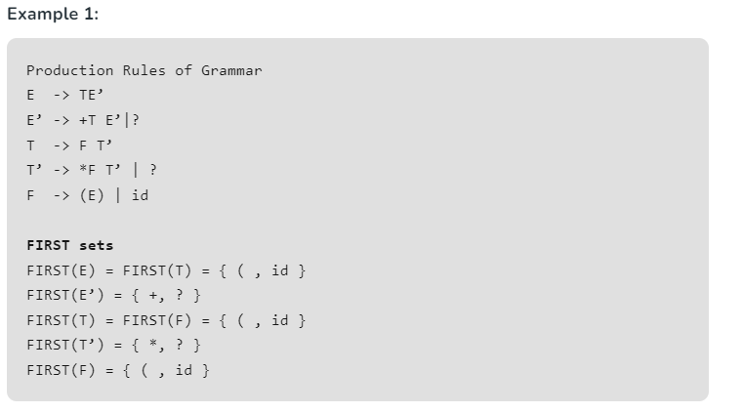

Slide 16
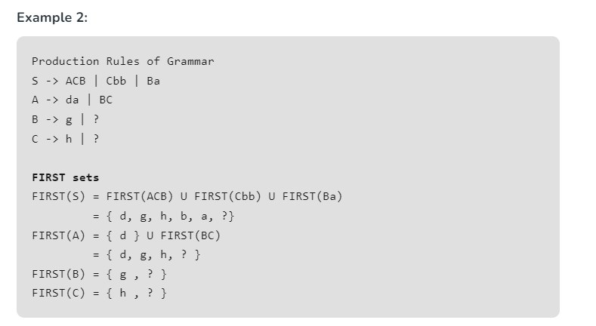

Slide 17
Notes:
The grammar used above is Context-Free Grammar (CFG). Syntax of most programming languages can be specified using CFG.
CFG is of the form A -> B, where A is a single Non-Terminal, and B can be a set of grammar symbols ( i.e. Terminals as well as Non-Terminals)

Slide 18
Features of first set
Definition: The FIRST set of a nonterminal symbol is the set of terminal symbols that can appear as the first symbol in a string derived from that nonterminal. In other words, it is the set of all possible starting symbols for a string derived from that nonterminal.
Calculation: The FIRST set for each nonterminal symbol is calculated by examining the productions for that symbol and determining which terminal symbols can appear as the first symbol in a string derived from that production.
Recursive Descent Parsing: The FIRST set is often used in recursive descent parsing, which is a top-down parsing technique that uses the FIRST set to determine which production to use at each step of the parsing process.
Ambiguity Resolution: The FIRST set can help resolve ambiguities in the grammar by providing a way to determine which production to use based on the next input symbol.
Follow Set: The FOLLOW set is another concept used in syntax analysis that represents the set of symbols that can appear immediately after a nonterminal symbol in a derivation. The FOLLOW set is often used in conjunction with the FIRST set to resolve parsing conflicts and ensure that the parser can correctly identify the structure of the input code

Slide 19
Advantages of first set
Improved parsing: FIRST set can be used to determine which production rule should be used to expand a non-terminal in an LL or LR parser, which helps to improve the accuracy and efficiency of the parsing process.
Ambiguity resolution: FIRST set can be used to resolve ambiguities in the grammar, by determining which production rule should be used in cases where multiple production rules can apply to the same non-terminal.
Simplified error handling: By determining which production rule should be used based on the FIRST set, an LL or LR parser can detect errors in the source code more quickly and accurately

Slide 20
Dis advantages
Complexity: Computing FIRST set can be a complex process, especially for grammars with many non-terminals and production rules.
Limited applicability: FIRST set is mainly used in LL and LR parsing algorithms, and may not be applicable to other types of parsing algorithms.
Limitations of LL parsing: LL parsing is limited in its ability to handle certain types of grammars, such as those with left-recursive rules, which can lead to an infinite loop in the parser.
Overall, the use of FIRST set in syntax analysis can improve the accuracy and efficiency of the parsing process, but it should be balanced against the complexity and limitations of the parsing algorithm being used

Slide 21


Why follow
The parser faces one more problem. Let us consider below grammar to understand this problem.
As the first character in the input is a, the parser applies the rule A->aBb.

Slide 22
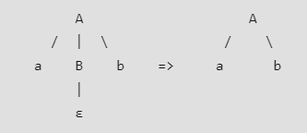
Cont.
Now the parser checks for the second character of the input string which is b, and the Non-Terminal to derive is B, but the parser can’t get any string derivable from B that contains b as first character. But the Grammar does contain a production rule B -> ε, if that is applied then B will vanish, and the parser gets the input “ab”, as shown below. But the parser can apply it only when it knows that the character that follows B in the production rule is same as the current character in the input
In RHS of A -> aBb, b follows Non-Terminal B, i.e. FOLLOW(B) = {b}, and the current input character read is also b. Hence the parser applies this rule. And it is able to get the string “ab” from the given grammar

Slide 23
So FOLLOW can make a Non-terminal vanish out if needed to generate the string from the parse tree.
The conclusions is, we need to find FIRST and FOLLOW sets for a given grammar so that the parser can properly apply the needed rule at the correct position.
In the next article, we will discuss formal definitions of FIRST and FOLLOW, and some easy rules to compute these sets

Slide 24
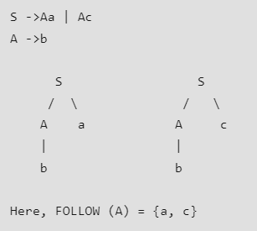
Follow set in sytax analysis
FOLLOW set in compiler design are used to identify the terminal symbol immediately after a non-terminal in a given language. FOLLOW set is also used to avoid backtracking same as the first set. The only difference is FOLLOW set works on vanishing non-terminal on the right-hand side so that decision-making gets easier for the compiler while parsing
Follow(X) to be the set of terminals that can appear immediately to the right of Non-Terminal X in some sentential form. Example:

Slide 25
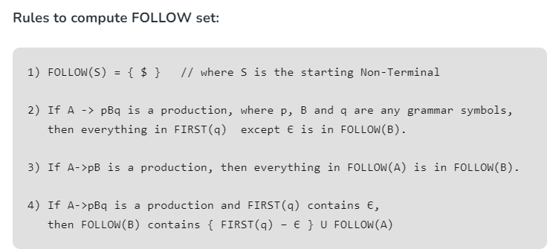

Slide 26
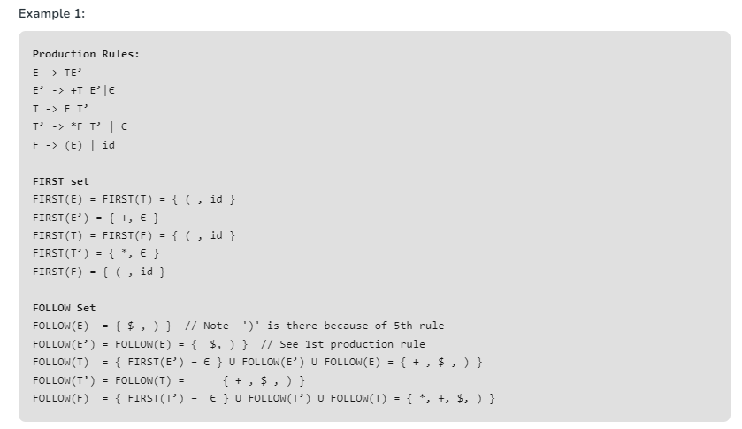

Slide 27
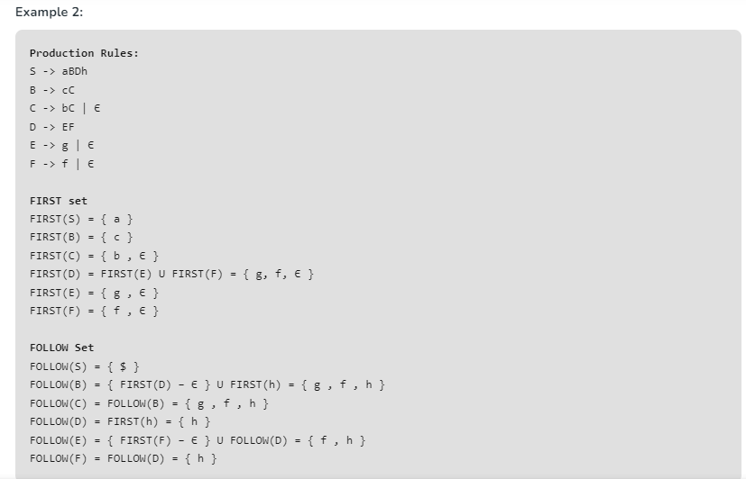

Slide 28
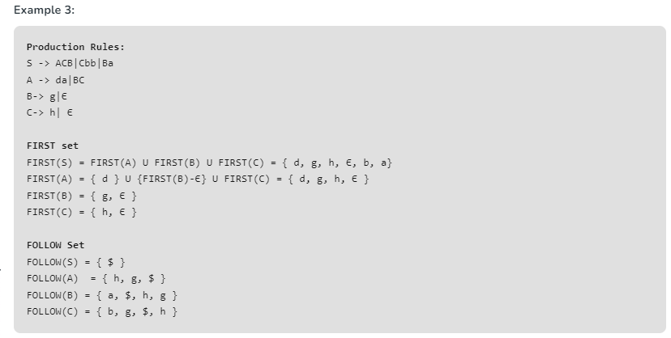

Slide 29
Note:
Є as a FOLLOW doesn’t mean anything (Є is an empty string).
$ is called end-marker, which represents the end of the input string, hence used while parsing to indicate that the input string has been completely processed.
The grammar used above is Context-Free Grammar (CFG). The syntax of a programming language can be specified using CFG.
CFG is of the form A -> B, where A is a single Non-Terminal, and B can be a set of grammar symbols ( i.e. Terminals as well as Non-Terminals)

